Slide 1


Python Image Processing with OpenCV
Welcome to this guide on image processing with Python and OpenCV! We'll learn to manipulate images programmatically.
By the end, you'll understand how to read, display, process, and save images using simple Python code.
by EMRE Akpınar

Slide 2
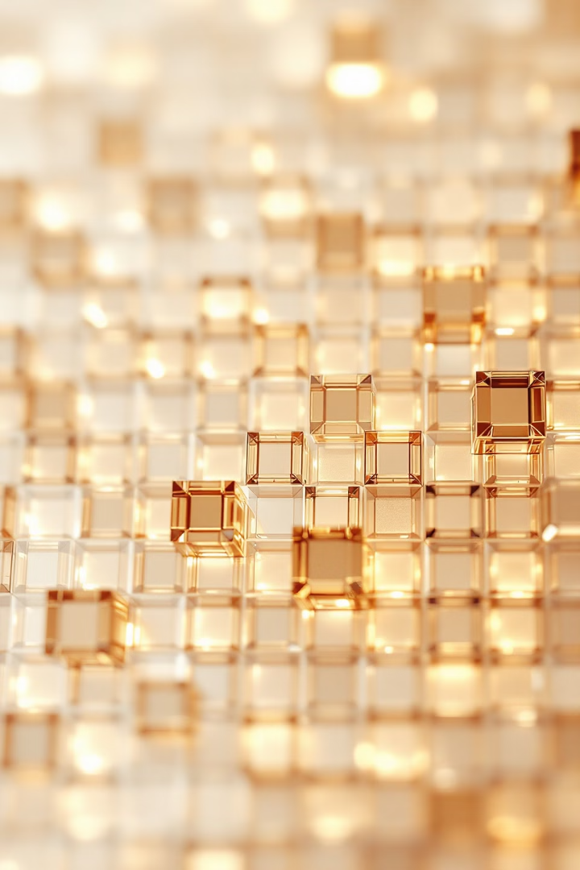
What is an Image in Programming?
Digital Format
Color Models
Images are matrices of pixel values. Each pixel contains color information stored as numbers.
OpenCV uses BGR (Blue-Green-Red) format. Each pixel has three values between 0-255.
Grayscale
Single-value pixels represent intensity only. Great for many processing algorithms.

Slide 3

Setting Up Your Environment
Install Python
Make sure you have Python installed on your system.
Install OpenCV
Run pip install opencv-python in your terminal or command prompt.
Create a Project
Make a new folder and Python file for your image processing code.
Add Test Images
Place image files in your project folder for easy access.

Slide 4
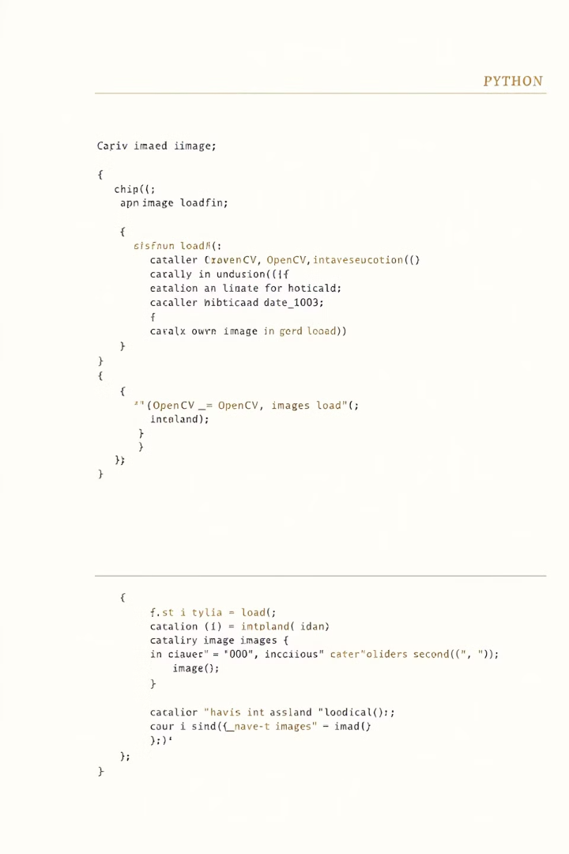
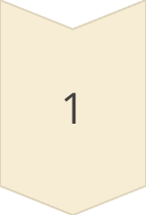
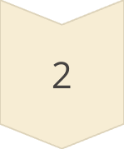
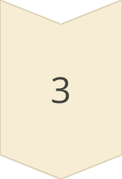
Reading Images with OpenCV
Import Library
Start by importing OpenCV with import cv2 at the top of your file.
Use imread() Function
Load an image with img = cv2.imread("filename.png").
Verify Success
Check if the image loaded by printing the image shape or dimensions.

Slide 5
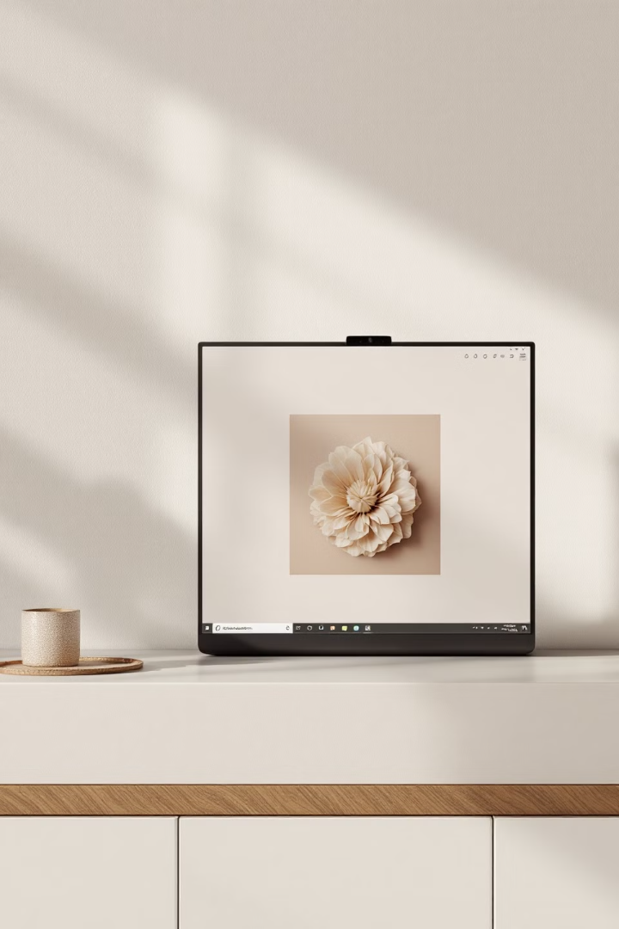



Displaying Images
Create Window
Wait for Input
Clean Up
Use cv2.imshow("Window Title", img) to display your image in a new window.
Add cv2.waitKey(0) to keep the window open until a key is pressed.
Close all windows with cv2.destroyAllWindows() when done.

Slide 6
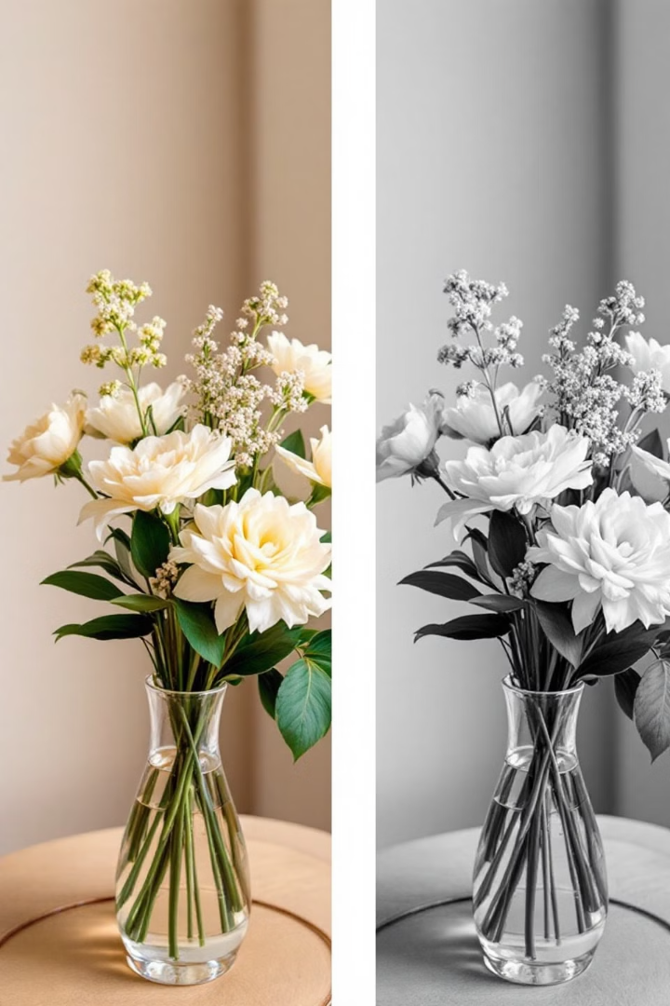
Image Color Transformations
1
Full Color (BGR)
Default color format in OpenCV. Three channels for blue, green, and red values.
2
Grayscale
Load directly in grayscale with cv2.imread("image.png", 0) or cv2.IMREAD_GRAYSCALE.
3
Binary
Convert grayscale to binary (black and white only) using thresholding techniques.

Slide 7
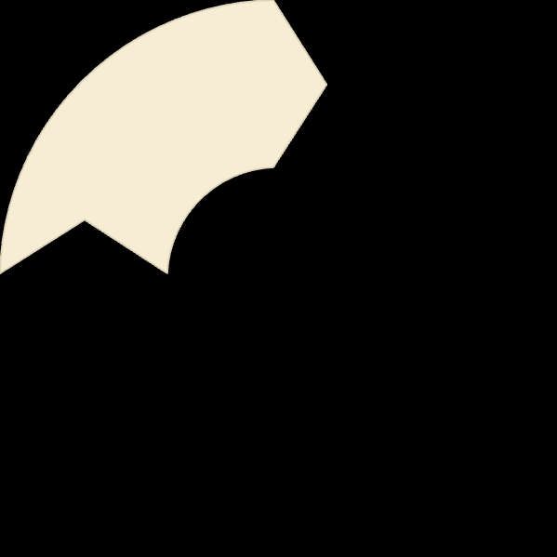
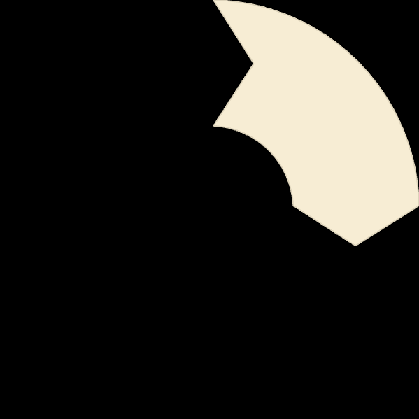


Handling Key Presses
Capture Key
Identify Key
1
Store the key code: key = cv2.waitKey(0)
Compare with ASCII values: if key == ord('s'):
2
Handle Exit
4
Perform Action
Close program with if key == 27: (ESC key)
3
Execute code based on the pressed key.

Slide 8
Saving Processed Images
The imwrite() Function
Supported Formats
Compression Parameters
Use cv2.imwrite("newimage.png", img) to save your processed image to disk.
Save in various formats like PNG, JPG, TIFF, and more.
For JPG, add quality: cv2.imwrite("image.jpg", img, [cv2.IMWRITE_JPEG_QUALITY, 90])
File extension in the filename determines the output format.
The first parameter is the filename, the second is the image variable.
Higher numbers mean better quality but larger file size.

Slide 9
Complete Image Processing Example
1
Import Libraries
2
Read the Image
3
Process the Image
Start by importing cv2 for image processing.
Load with img = cv2.imread("sample.png")
Convert to grayscale: gray = cv2.cvtColor(img, cv2.COLOR_BGR2GRAY)
4
Display Results
5
Save the Result
Show both original and processed images in separate windows.
Save the processed image: cv2.imwrite("processed.png", gray)

Slide 10
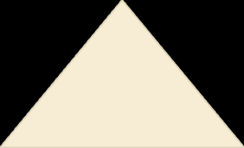

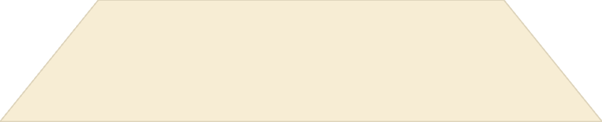
Next Steps in Your OpenCV Journey
Advanced Techniques
1
Edge detection, facial recognition, object tracking
Image Manipulation
2
Resizing, cropping, filtering, blending
Basic Operations
3
Reading, displaying, transforming, saving
You've learned the fundamental operations for working with images in Python and OpenCV. These basics will form the foundation for more complex image processing projects.

